Slide 1



SHOP FOR HOME
Capstone Project Group-2
MENTOR
Neeraj Kumar Kheria
SUBMITTED BY
A. Sravan
K. Chandana Sri
K. Kavya Sri
K. Kajal Singh
D. Hrishikesh Kiran

Slide 2
Contents
Problem Statement
Introduction
Requirements
User Stories
Admin Stories
Database Schema
Backend
AWS Deployment
Git Repository
Conclusion

Slide 3

Problem Statement
Shop For Home is a popular Store in the market for shopping the home décor stuff. Due to Covid 19 all the offline shopping stopped. So, the store wants to move to the cloud platforms and wants their own web application.

Slide 4
Introduction
Online shopping named ShopForHome is a form of E-commerce website which allows customers to directly buy home decor stuff over the internet using a web browser.
Online stores are available 24 hours a day, so people can buy at any time.
The customers must have access to internet to access the ShopForHome application.
Online Shopping can save time for both the buyer and retailer, reducing phone calls about availability, specifications, hours of operation or other information easily found on company and product pages.
The Application consists of two modules:
User Module
Admin Module

Slide 5










Requirements
Frontend:
Backend:
Database:
Deployment:
Git Repository:

Slide 6
User Stories
As a user I should be able to login, Logout and Register into the application.
As a user I should be able to see the products in different categories.
As a user I should be able to sort the products.
As a user I should be able to add the products into the shopping cart.
As a user I should be able to increase or decrease the quantity added in the cart.
As a user I should be able to add “n” number of products in the cart.
As a user I should be able to get the Wishlist option where I can add those products which I want but don’t want to order now.
As a user I should get different discount coupons.

Slide 7
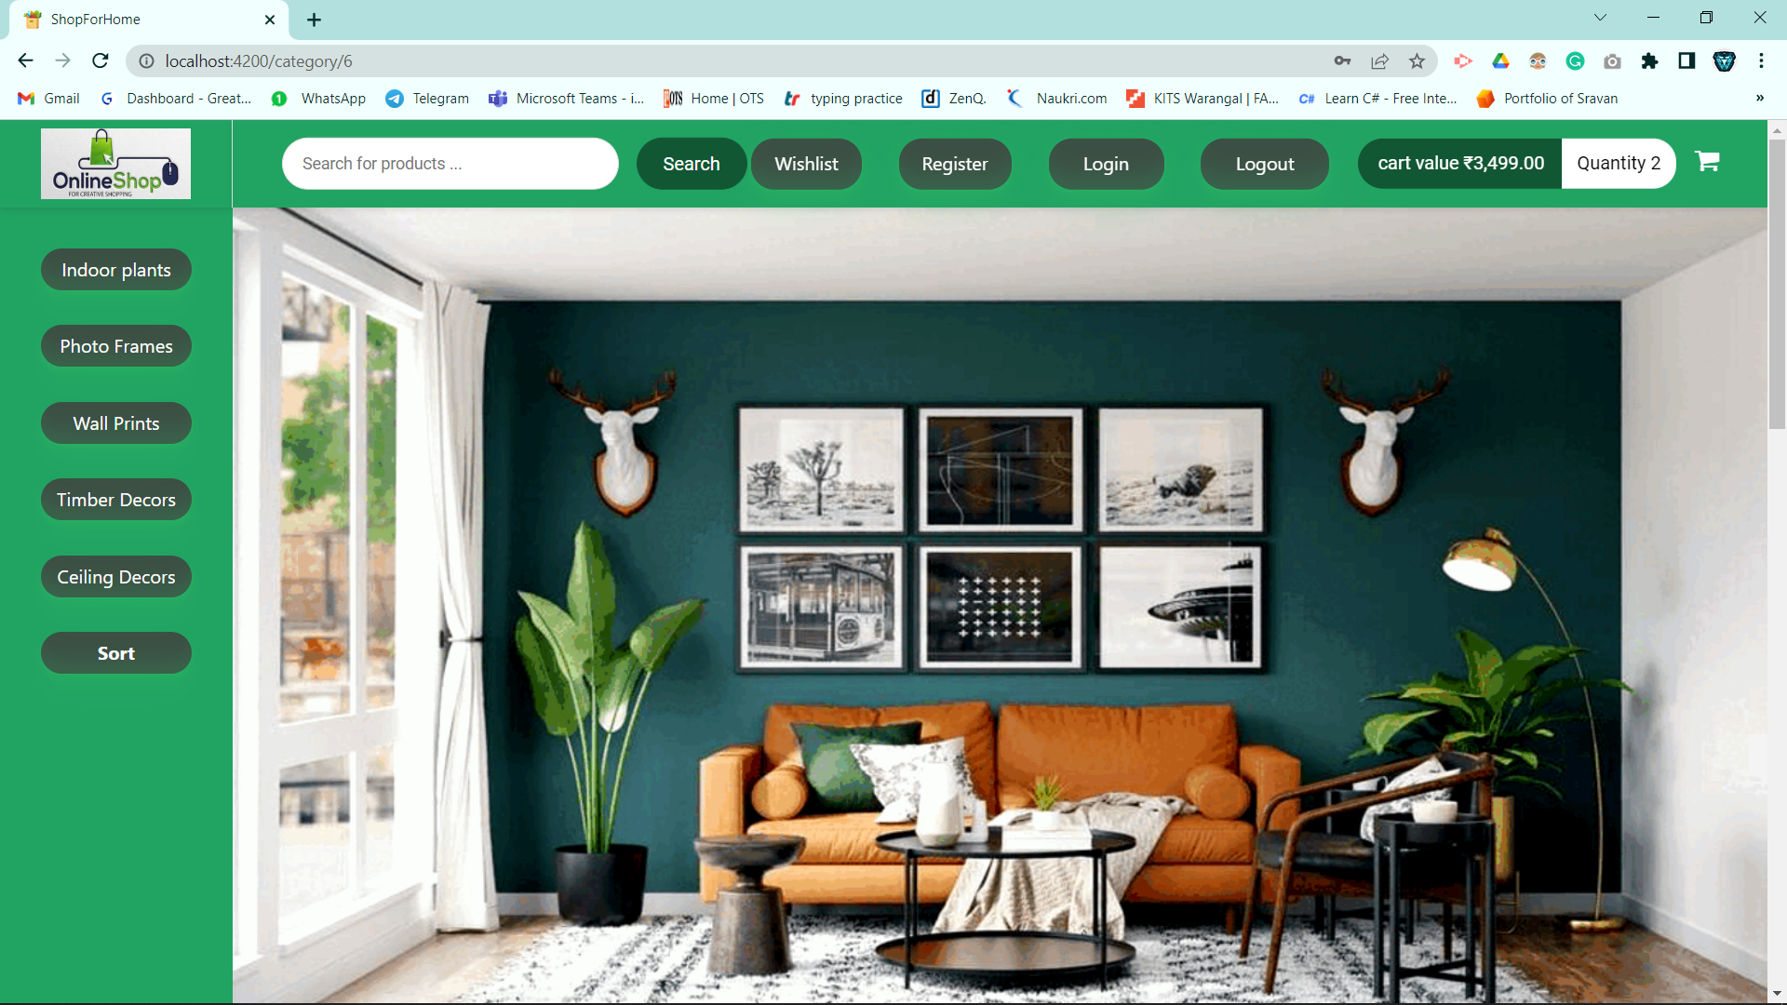
Home Page

Slide 8
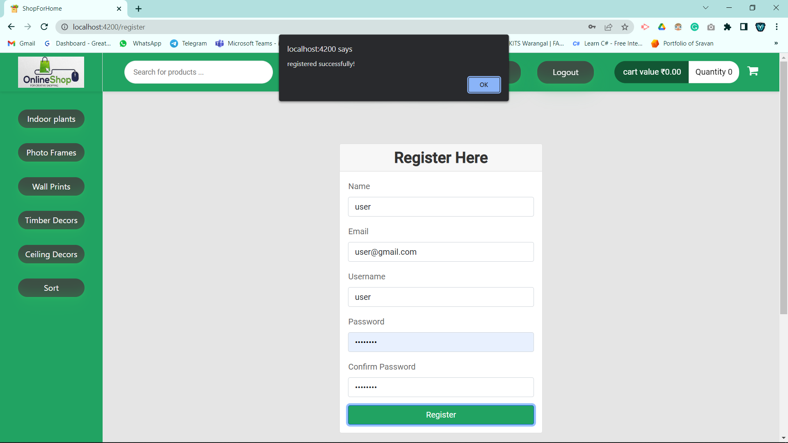
Registration Form

Slide 9
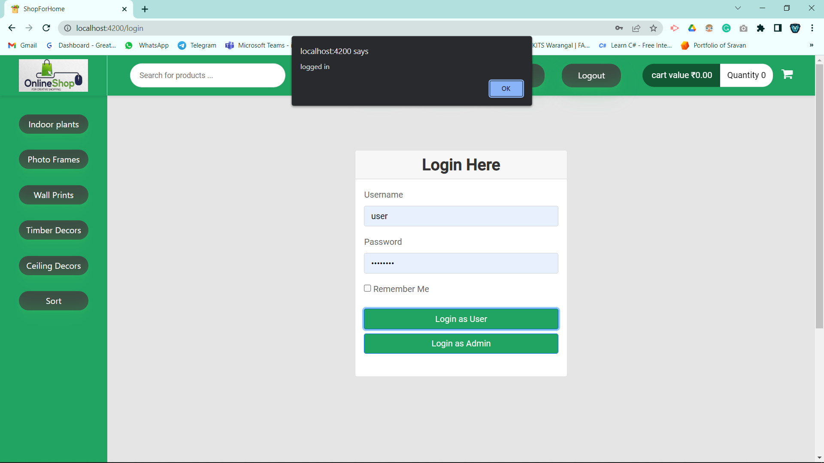
User Login Form

Slide 10
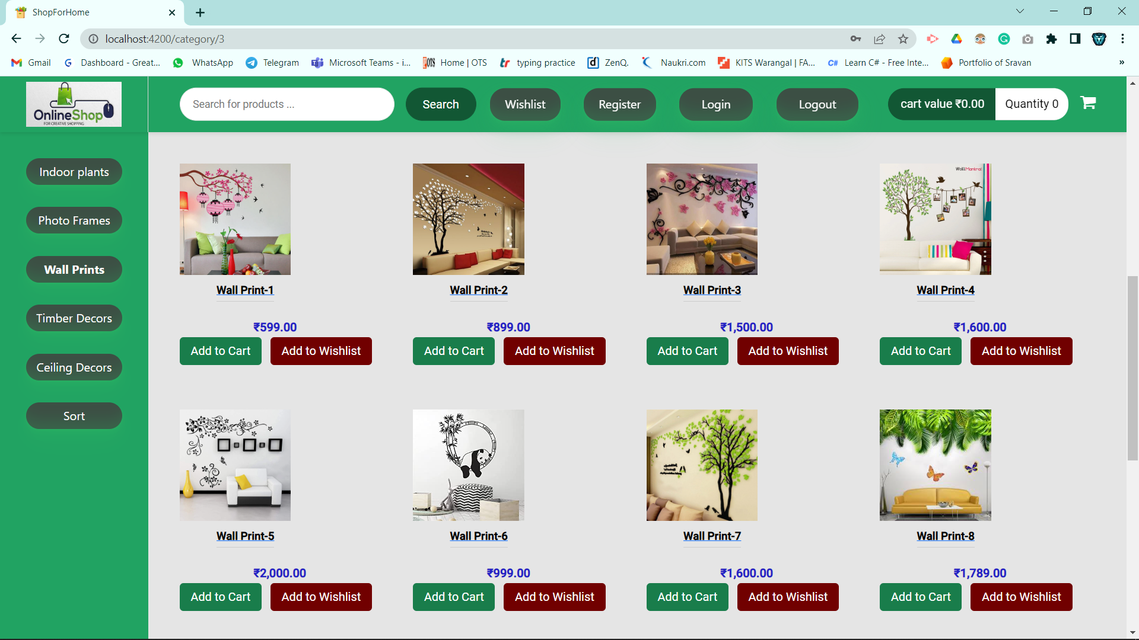
Product Categories

Slide 11
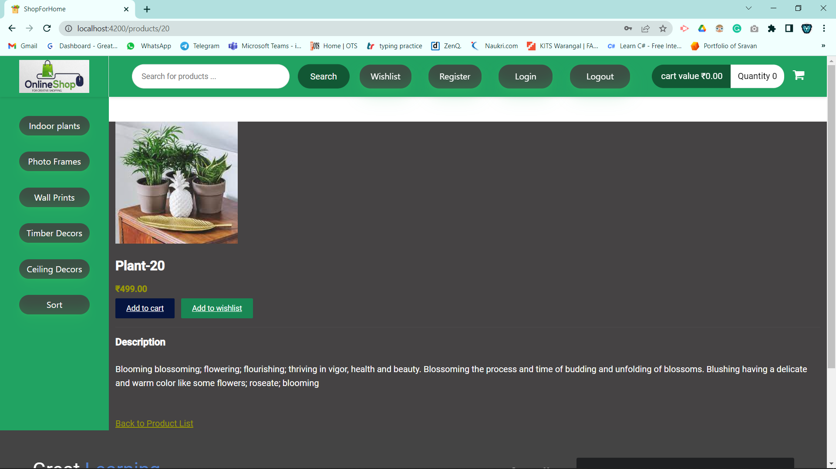
Get Product

Slide 12
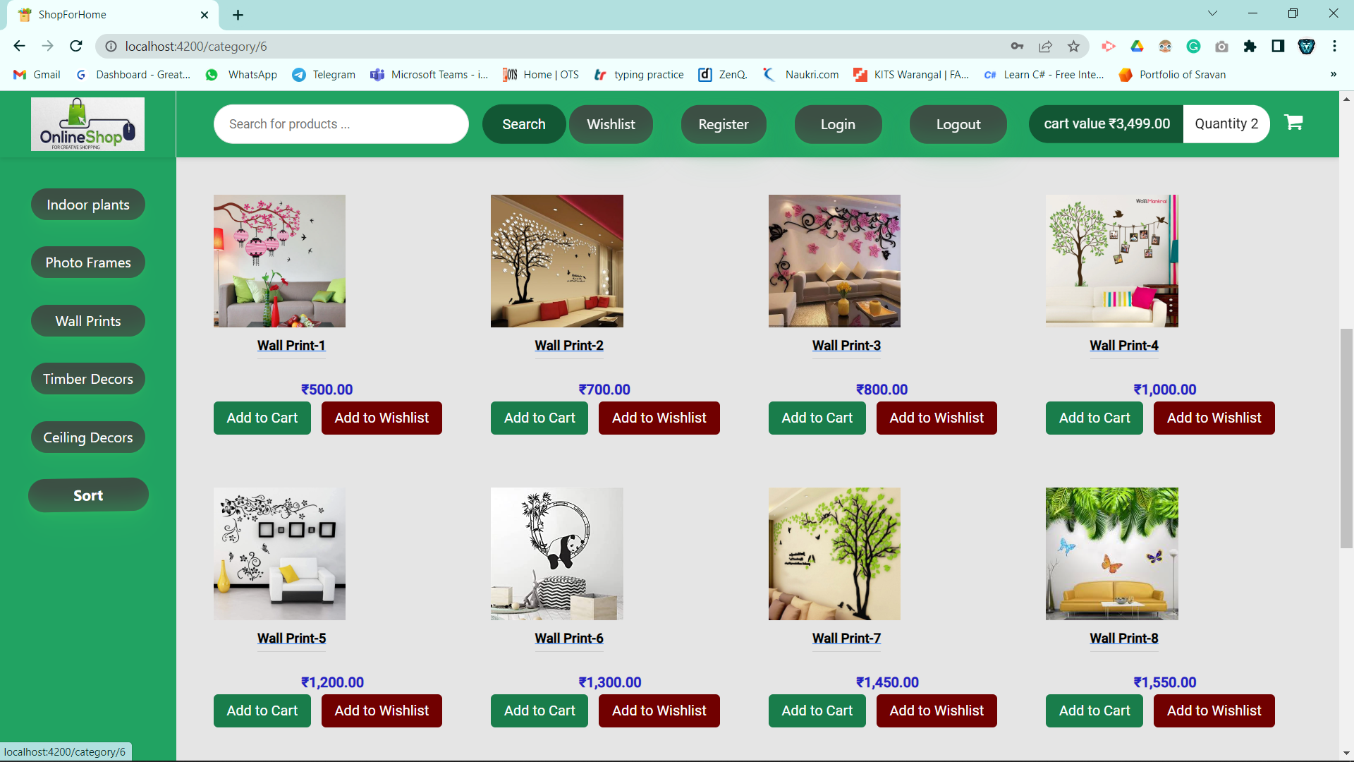
Sort

Slide 13
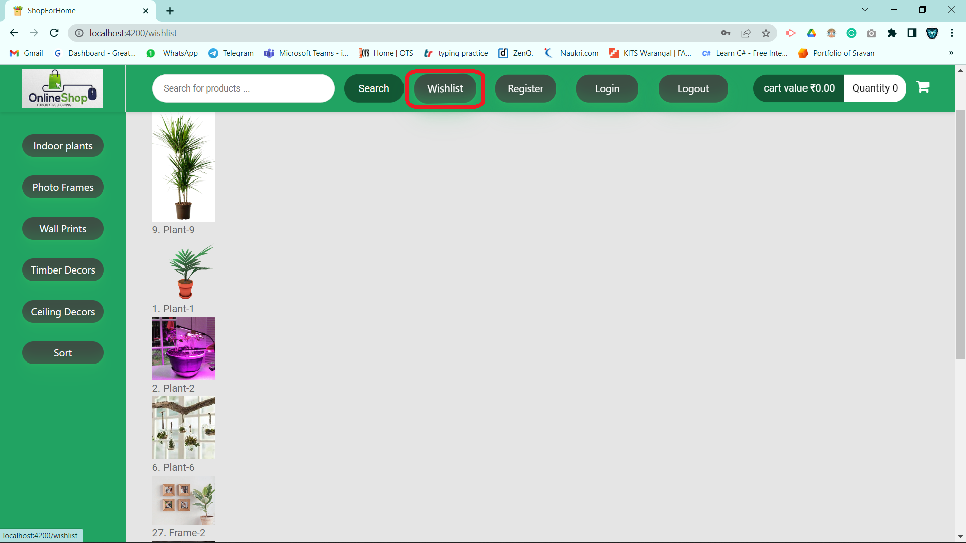
Wishlist

Slide 14
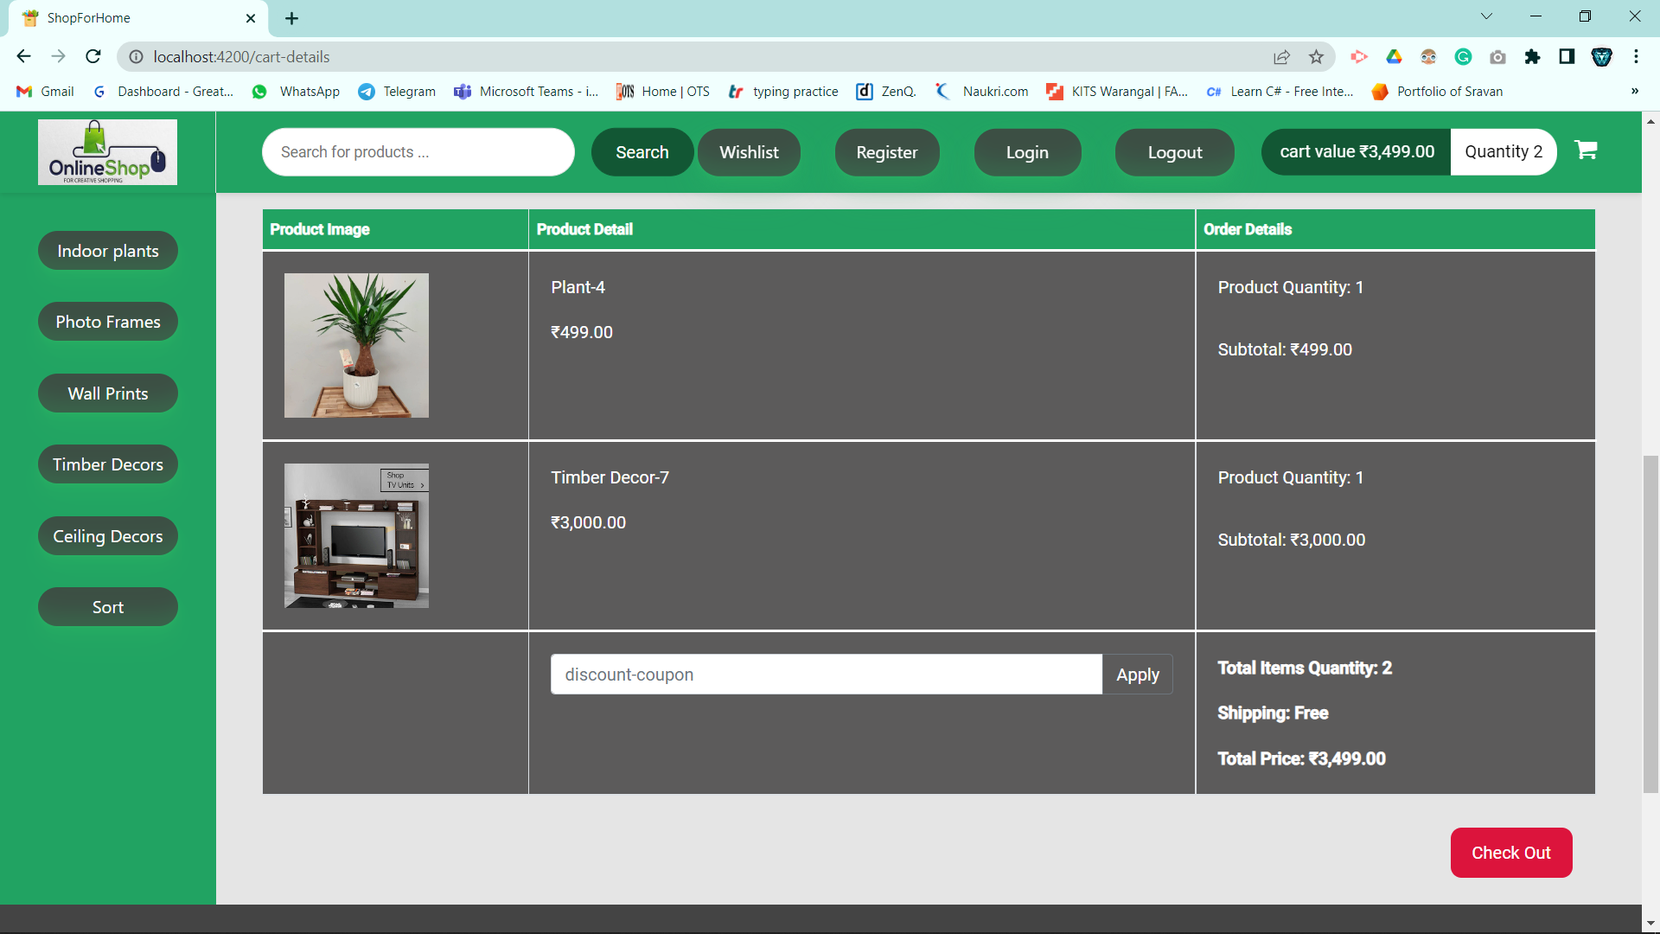
Cart

Slide 15
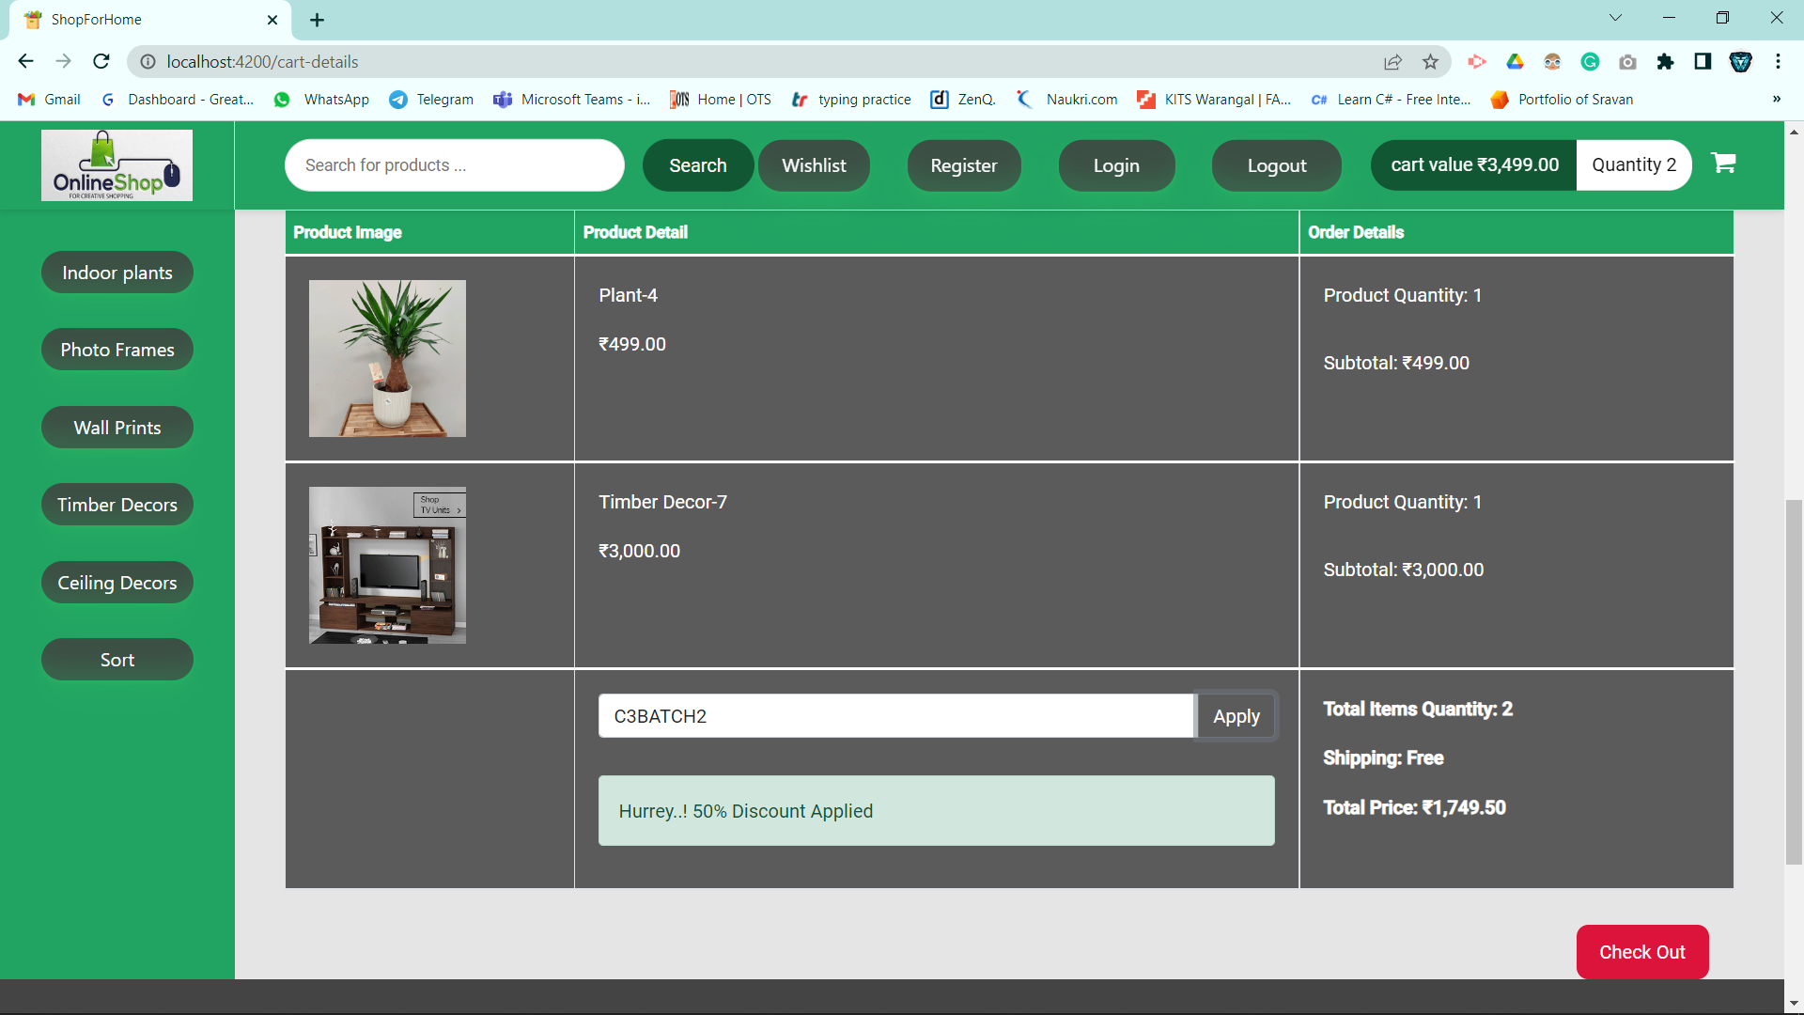
Discount Coupon

Slide 16
Admin Stories
As an Admin I should be able to login, Logout and Register into the application.
As an Admin I should be able to perform CRUD on Users.
As an Admin I should be able to Perform CRUD on the products.
As an Admin I should be able to get bulk upload option to upload a csv for products details
As an Admin I should be able to get the stocks.
As an Admin I should be able to mail if any stock is less than 10.
As an Admin I should be able to get the sales report of a specific duration.
As an Admin I should be able to set the discount coupons for the specific set of users

Slide 17
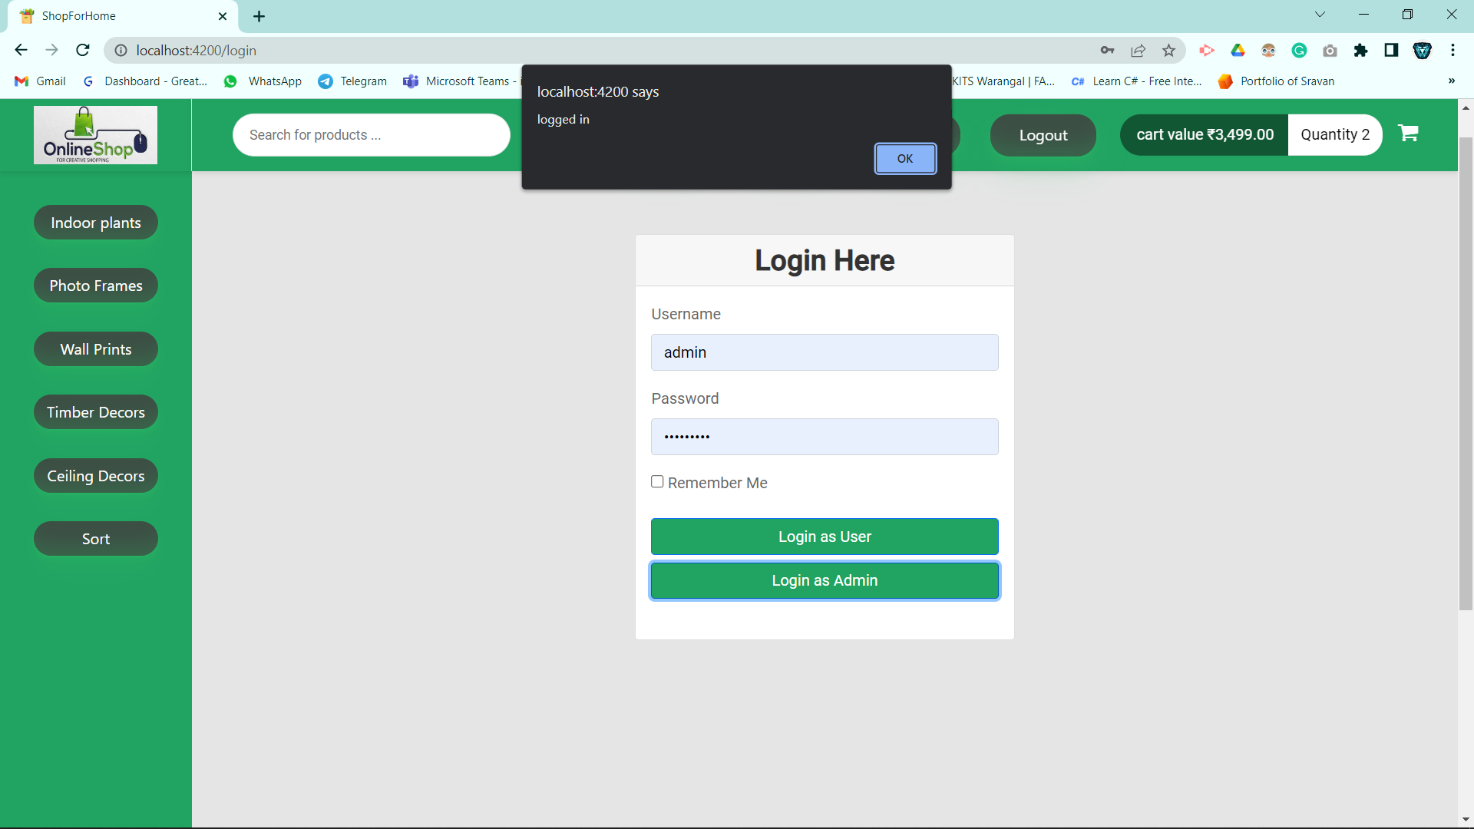
Admin Login

Slide 18
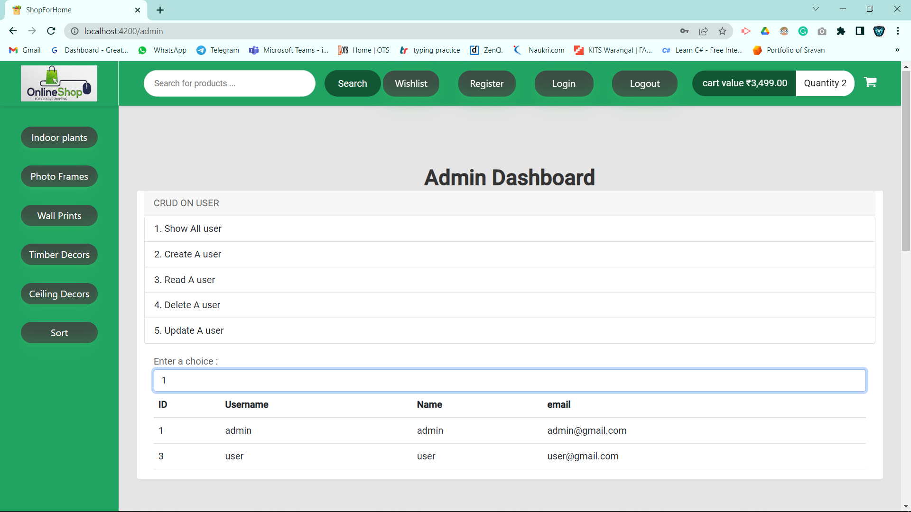
Admin Dashboard

Slide 19
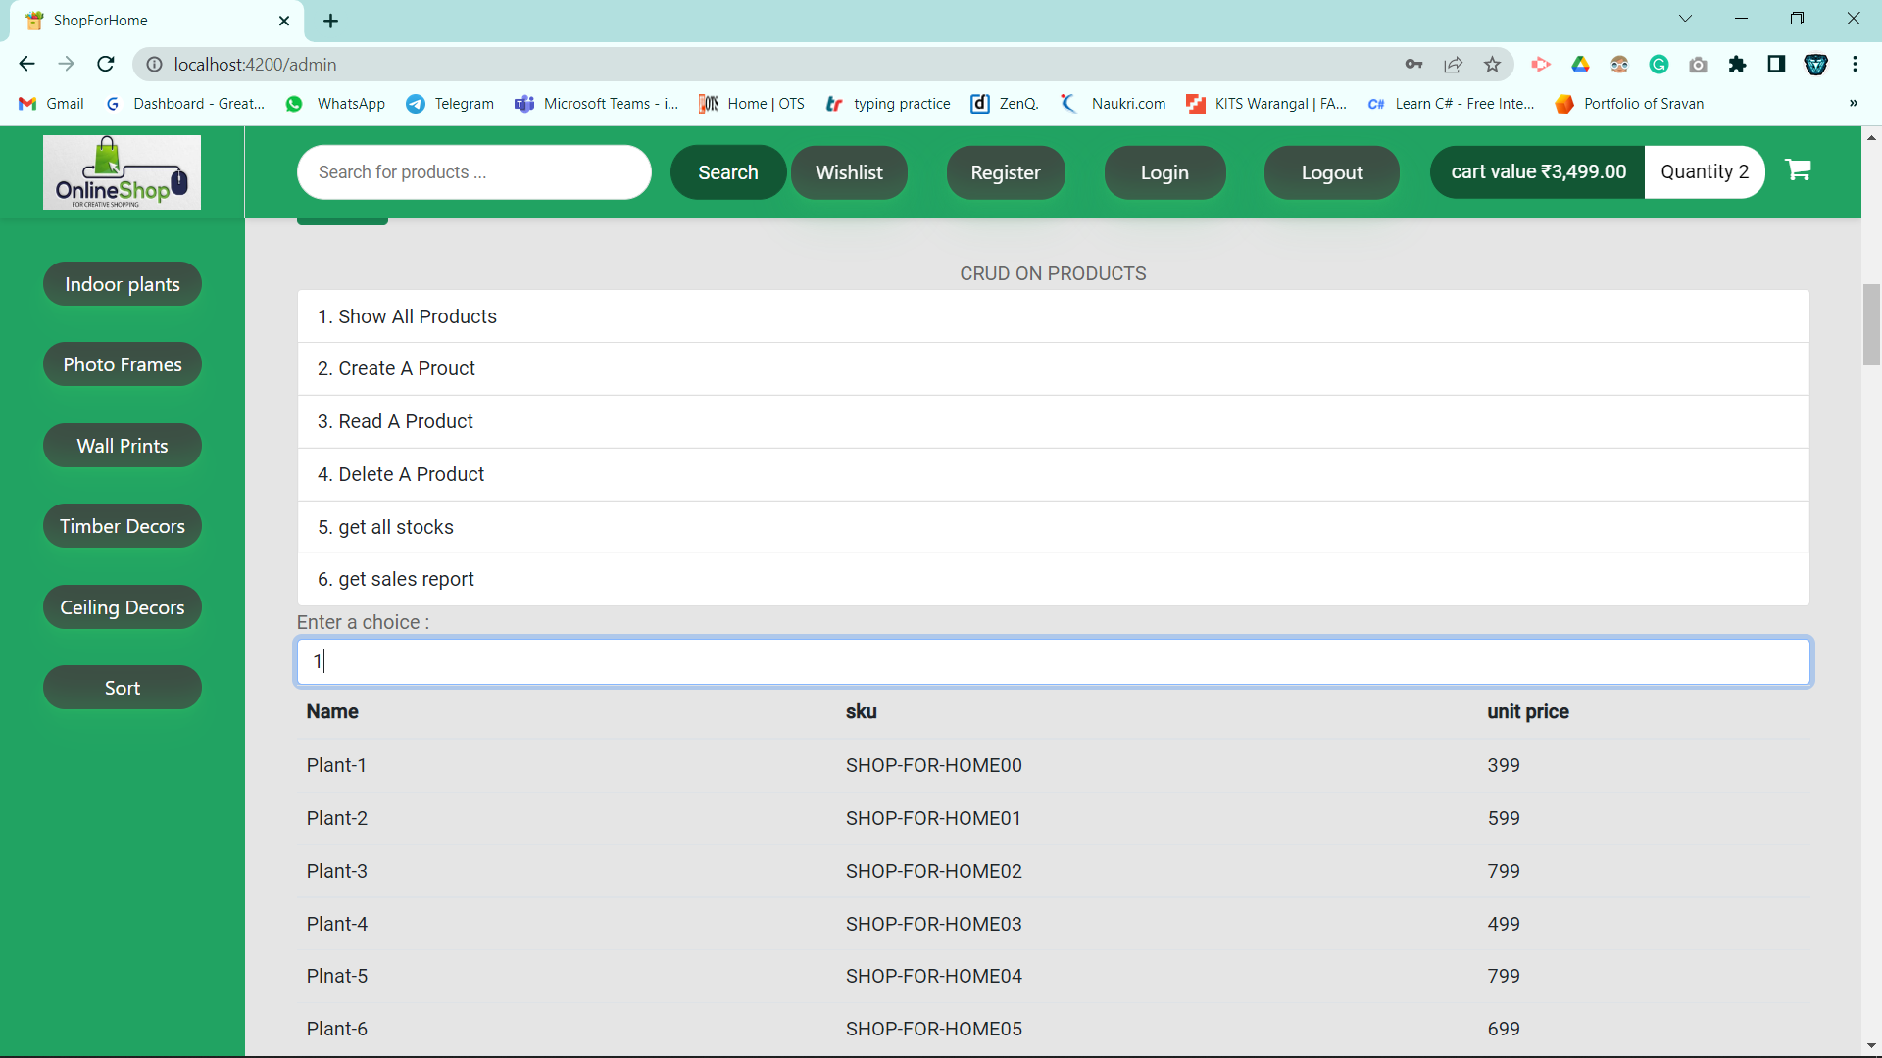
Admin Product Edit

Slide 20
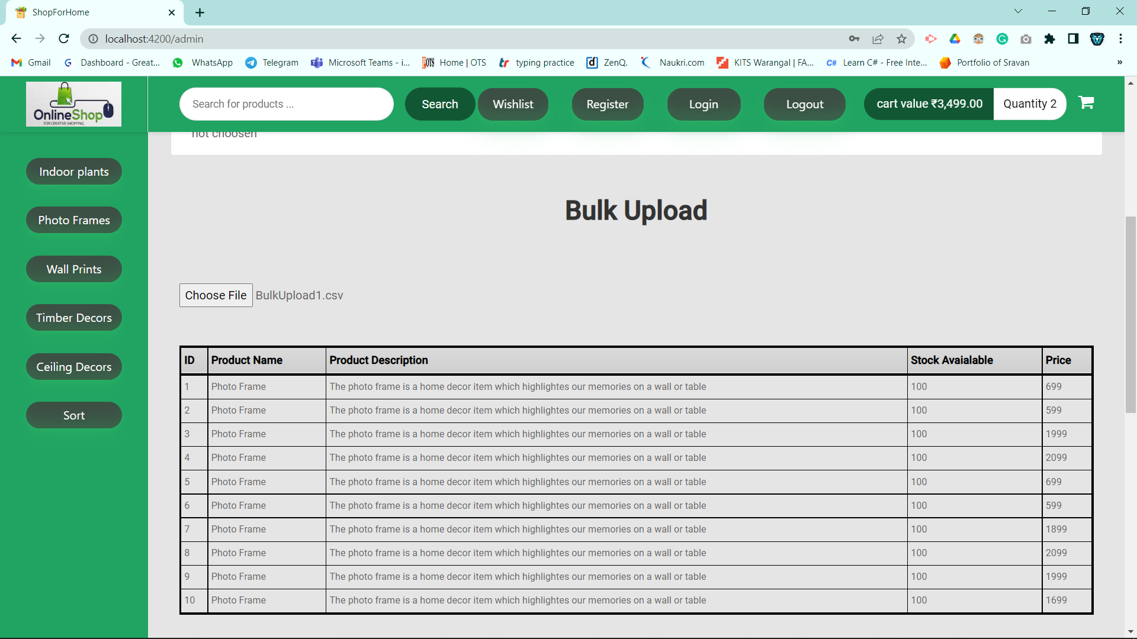
Bulk Upload

Slide 21
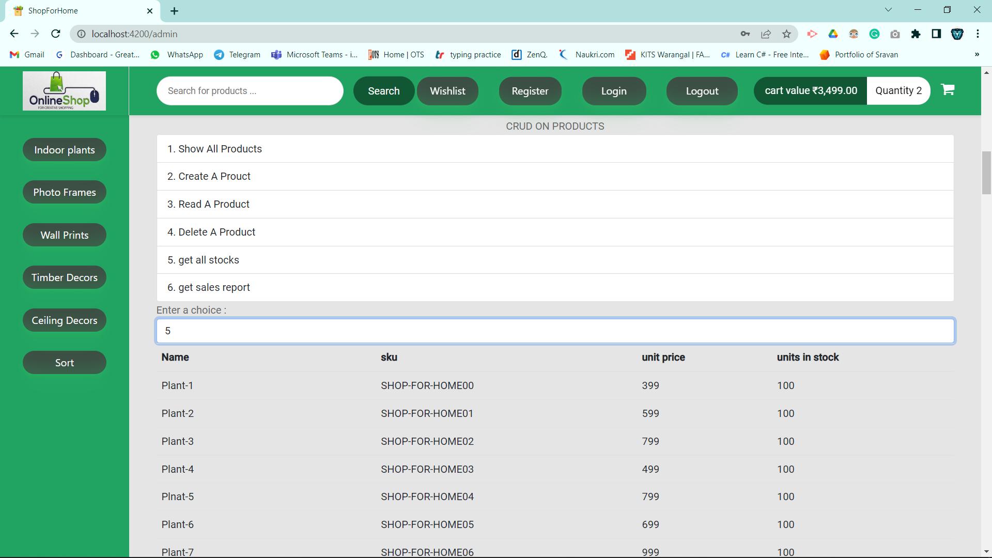
Stock Report

Slide 22
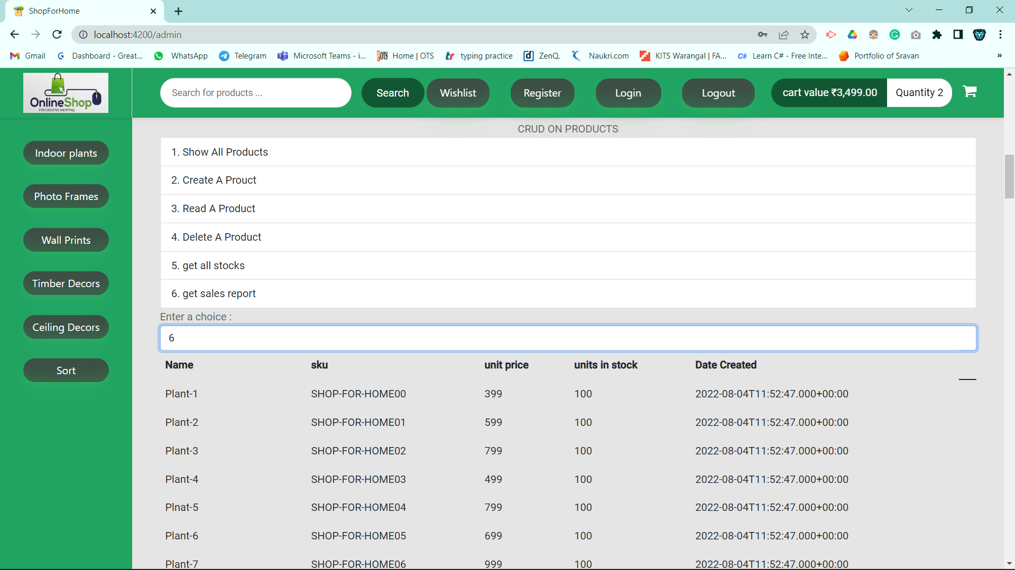
Sales Report

Slide 23
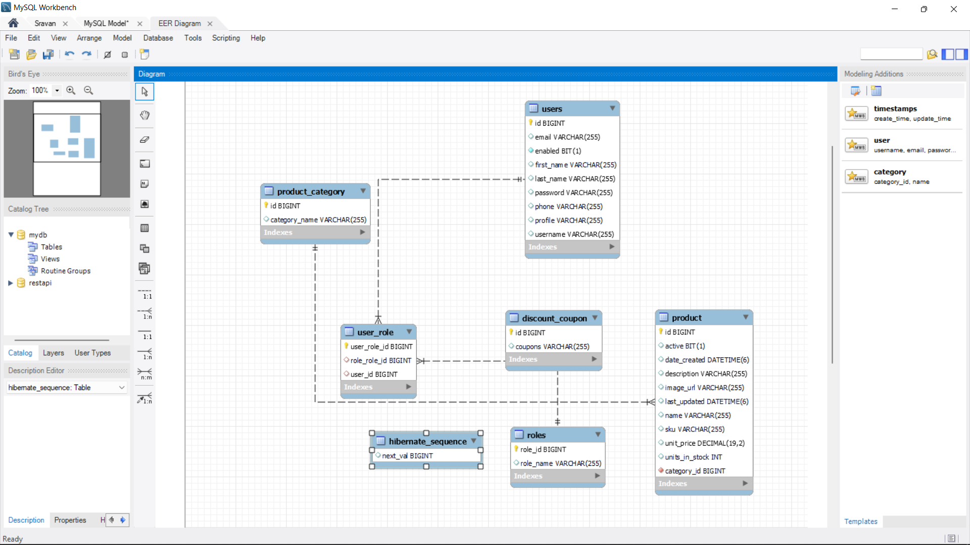
Database Schema

Slide 24
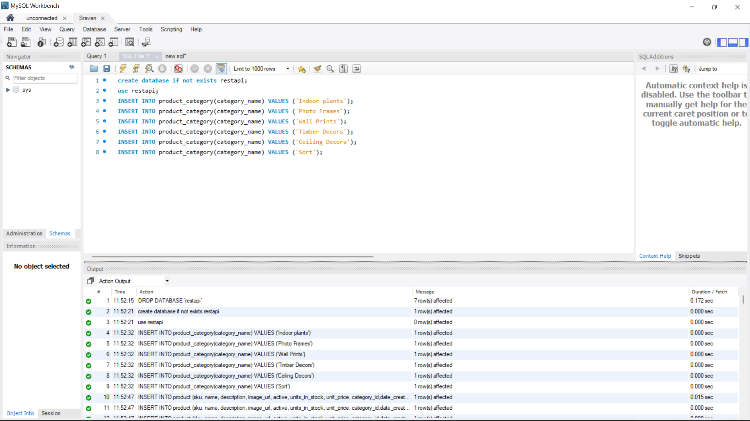
MySql Product Categories

Slide 25
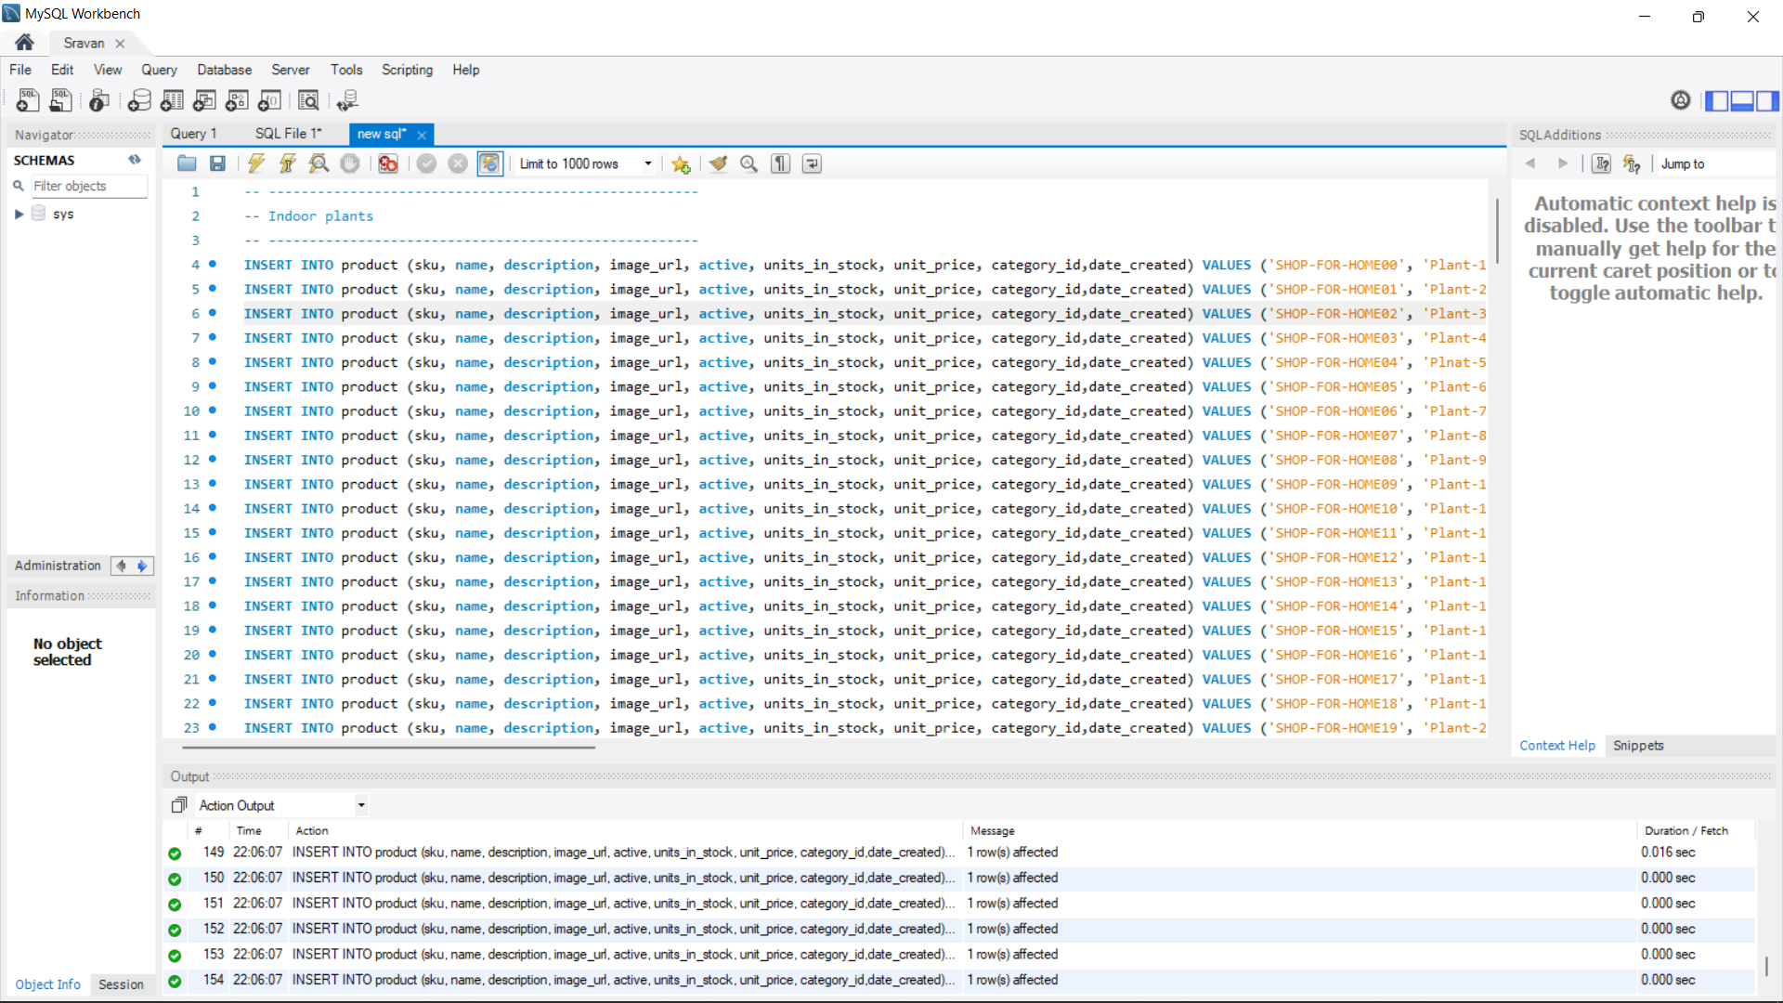
Database Product Details

Slide 26
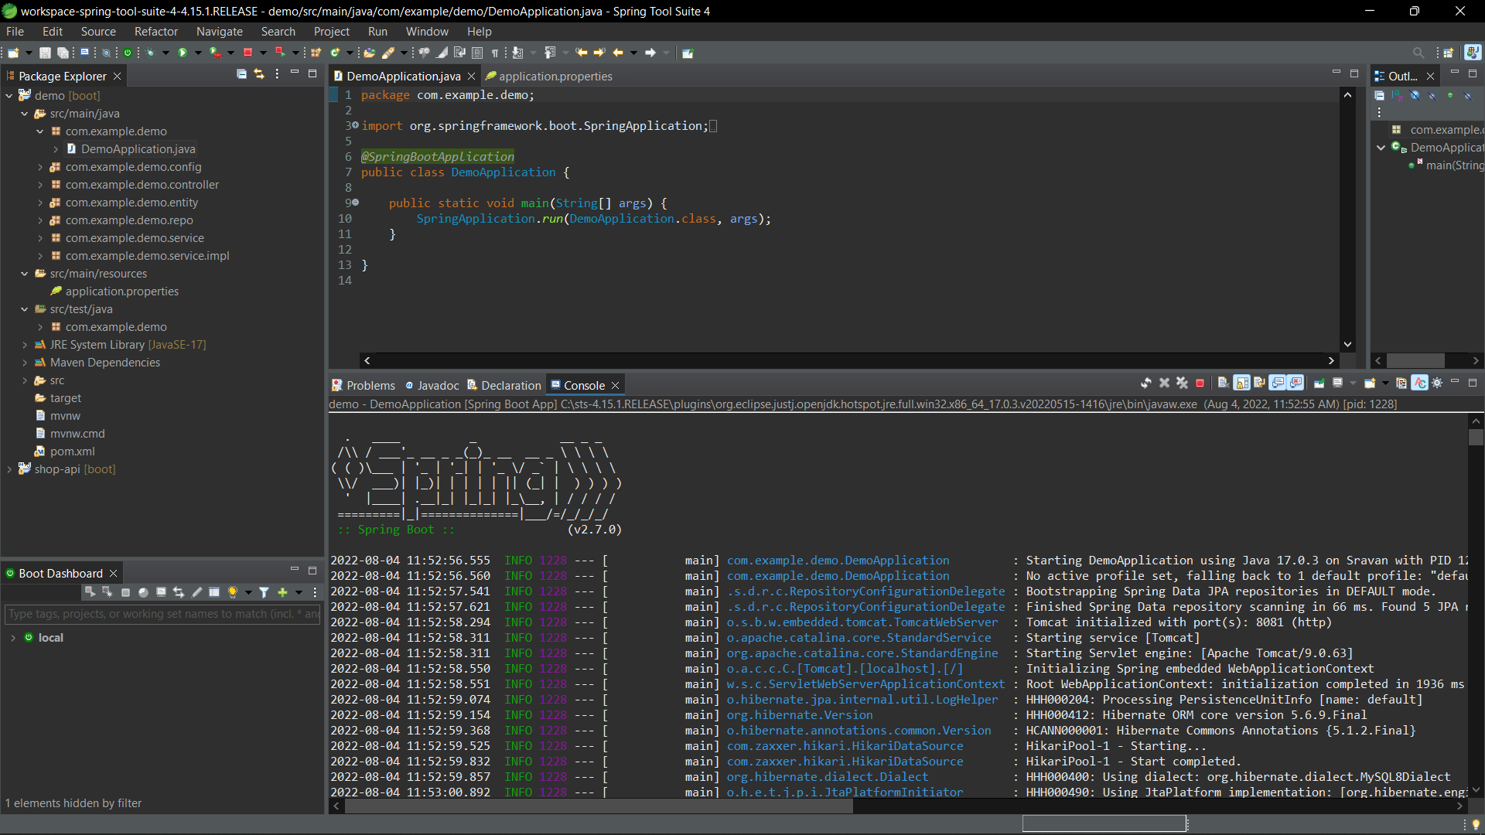
Backend API Application

Slide 27
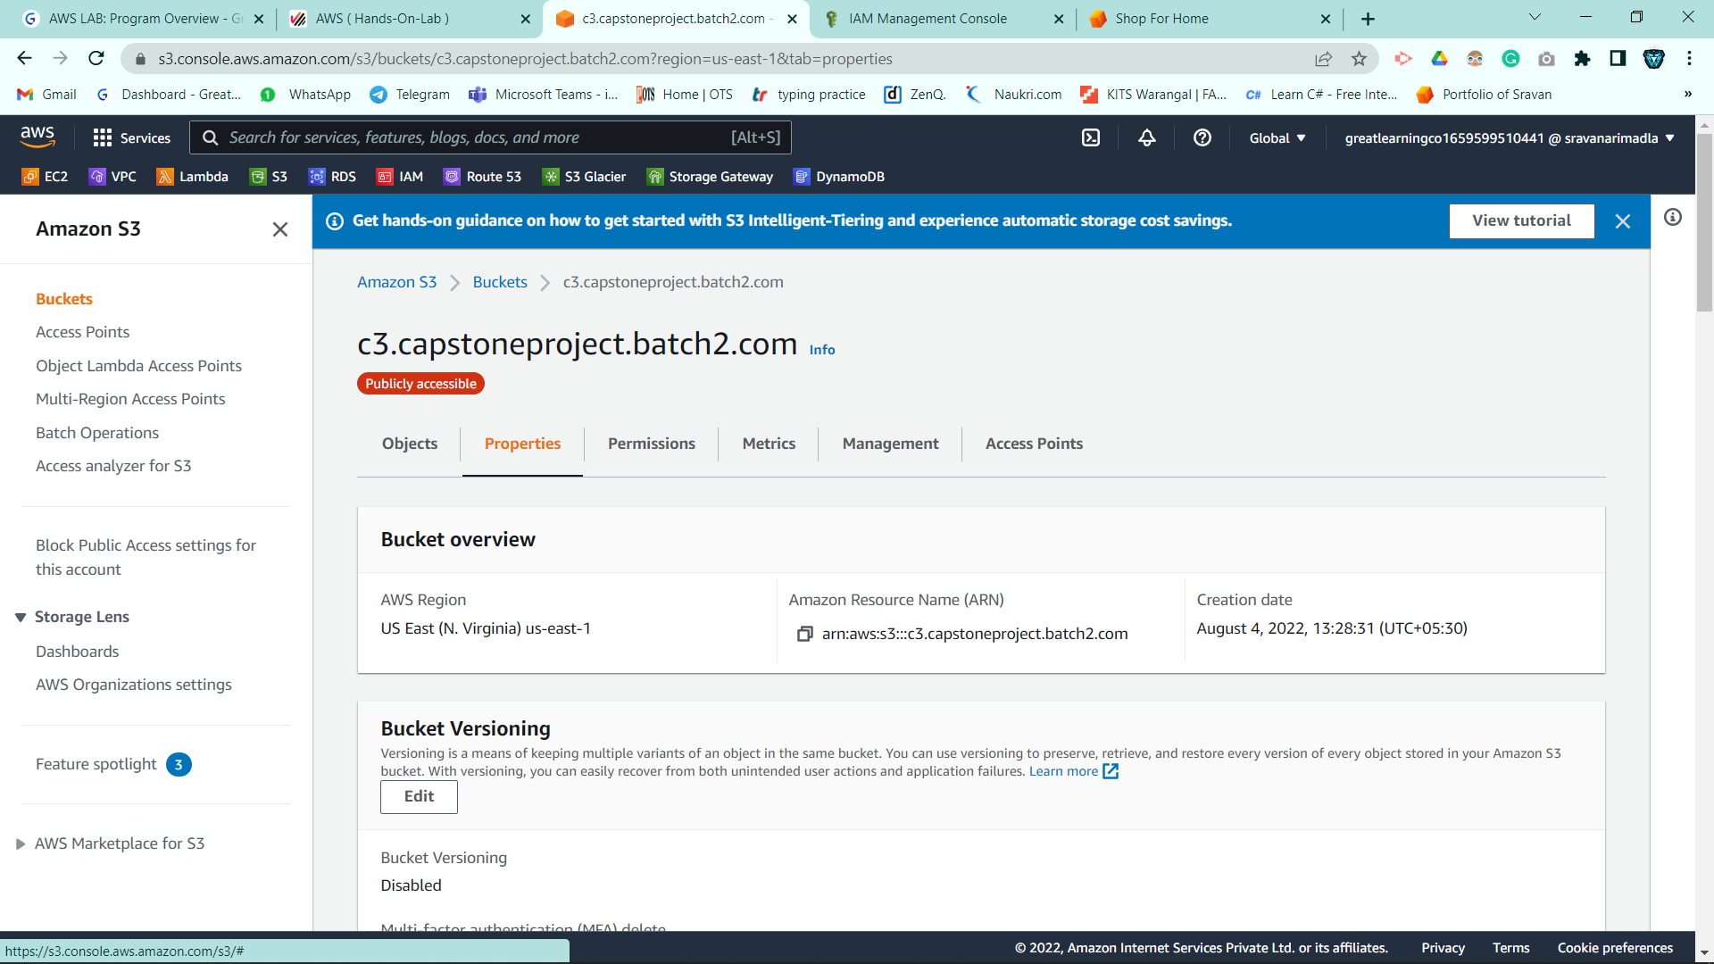
Aws Deployment using S3

Slide 28
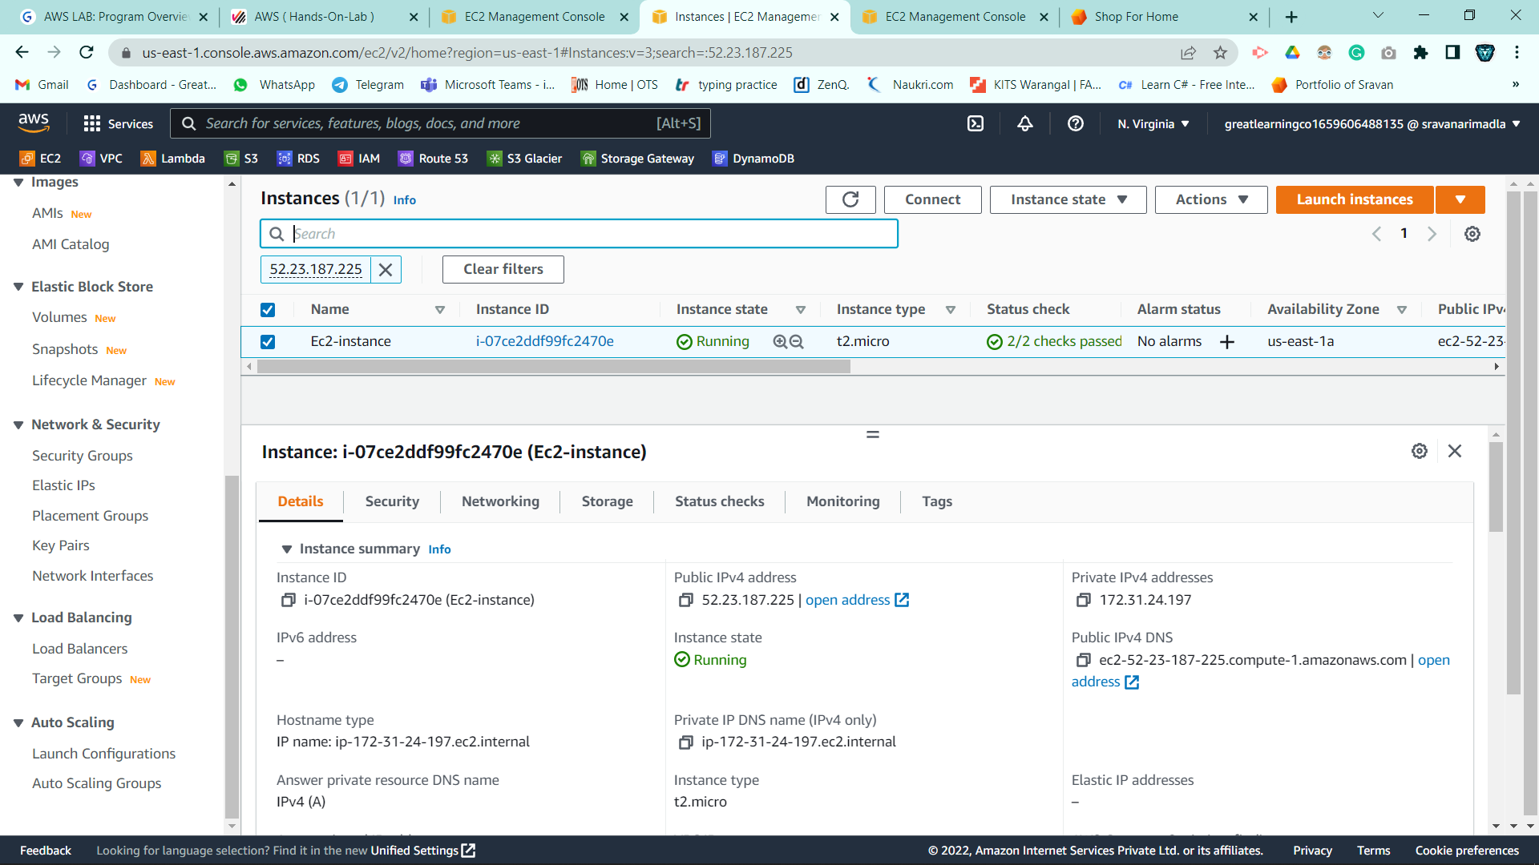
EC2 Instance

Slide 29
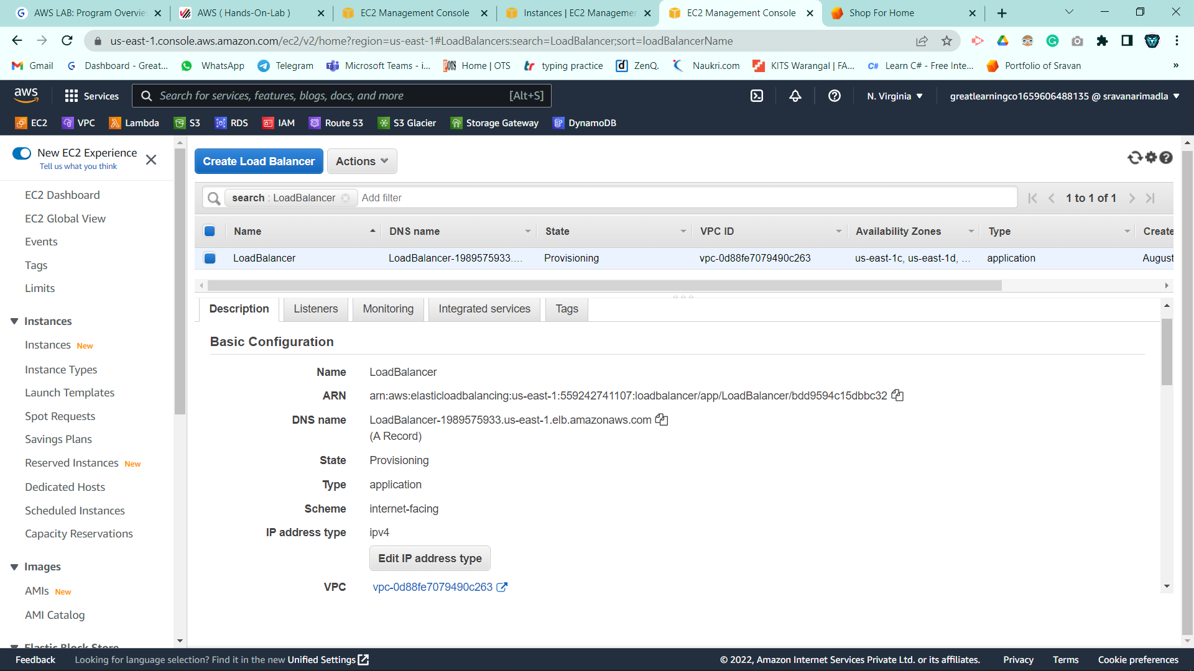
Load Balancer

Slide 30
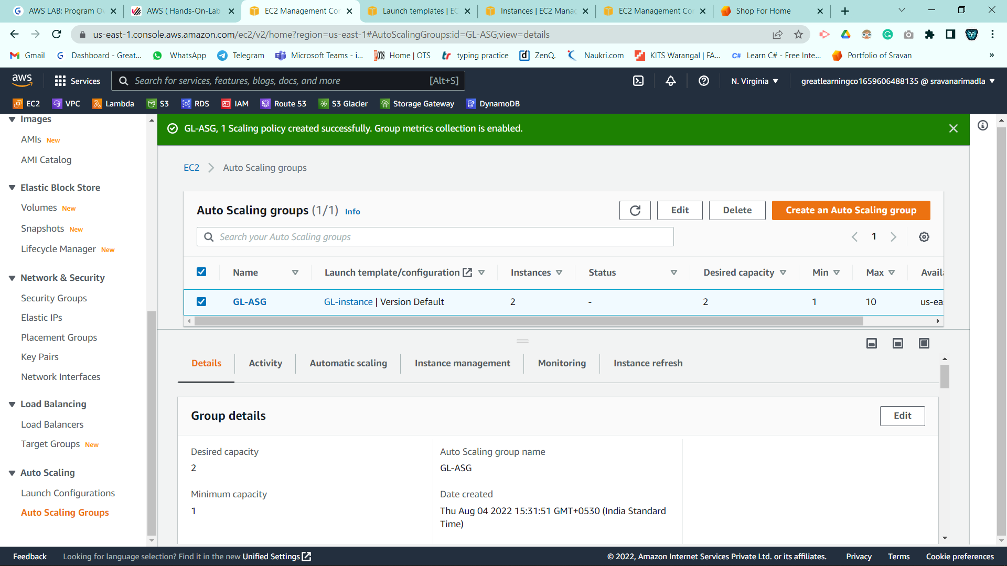
Auto Scaling

Slide 31
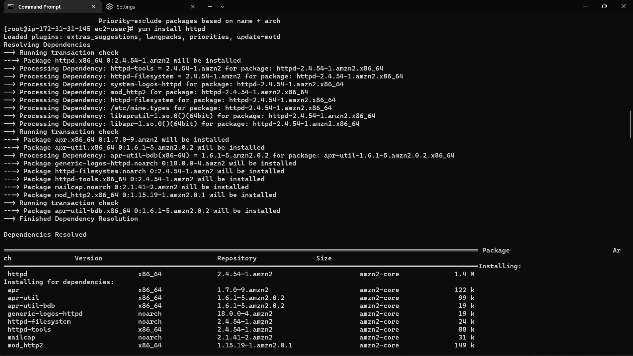
Connecting EC2 using Command Prompt

Slide 32
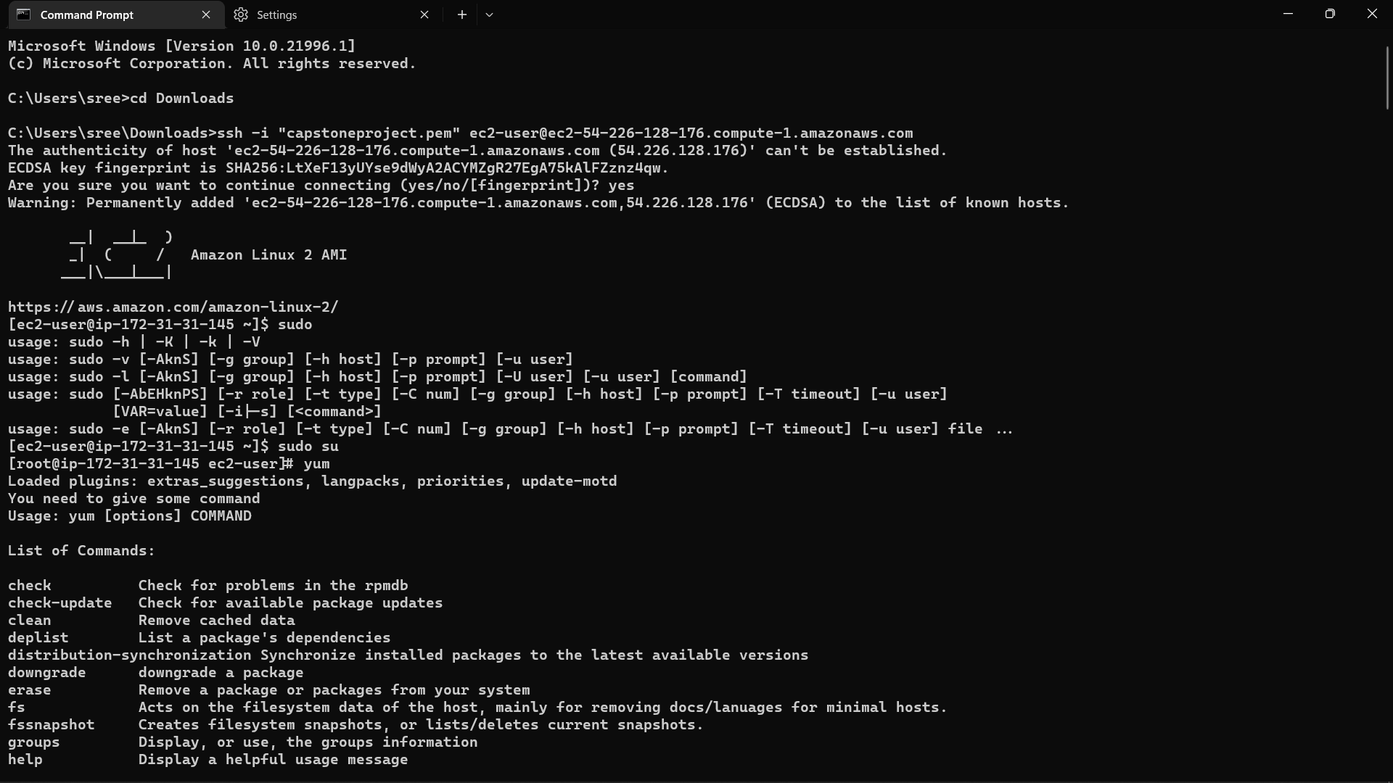
Connecting EC2 using Command Prompt

Slide 33
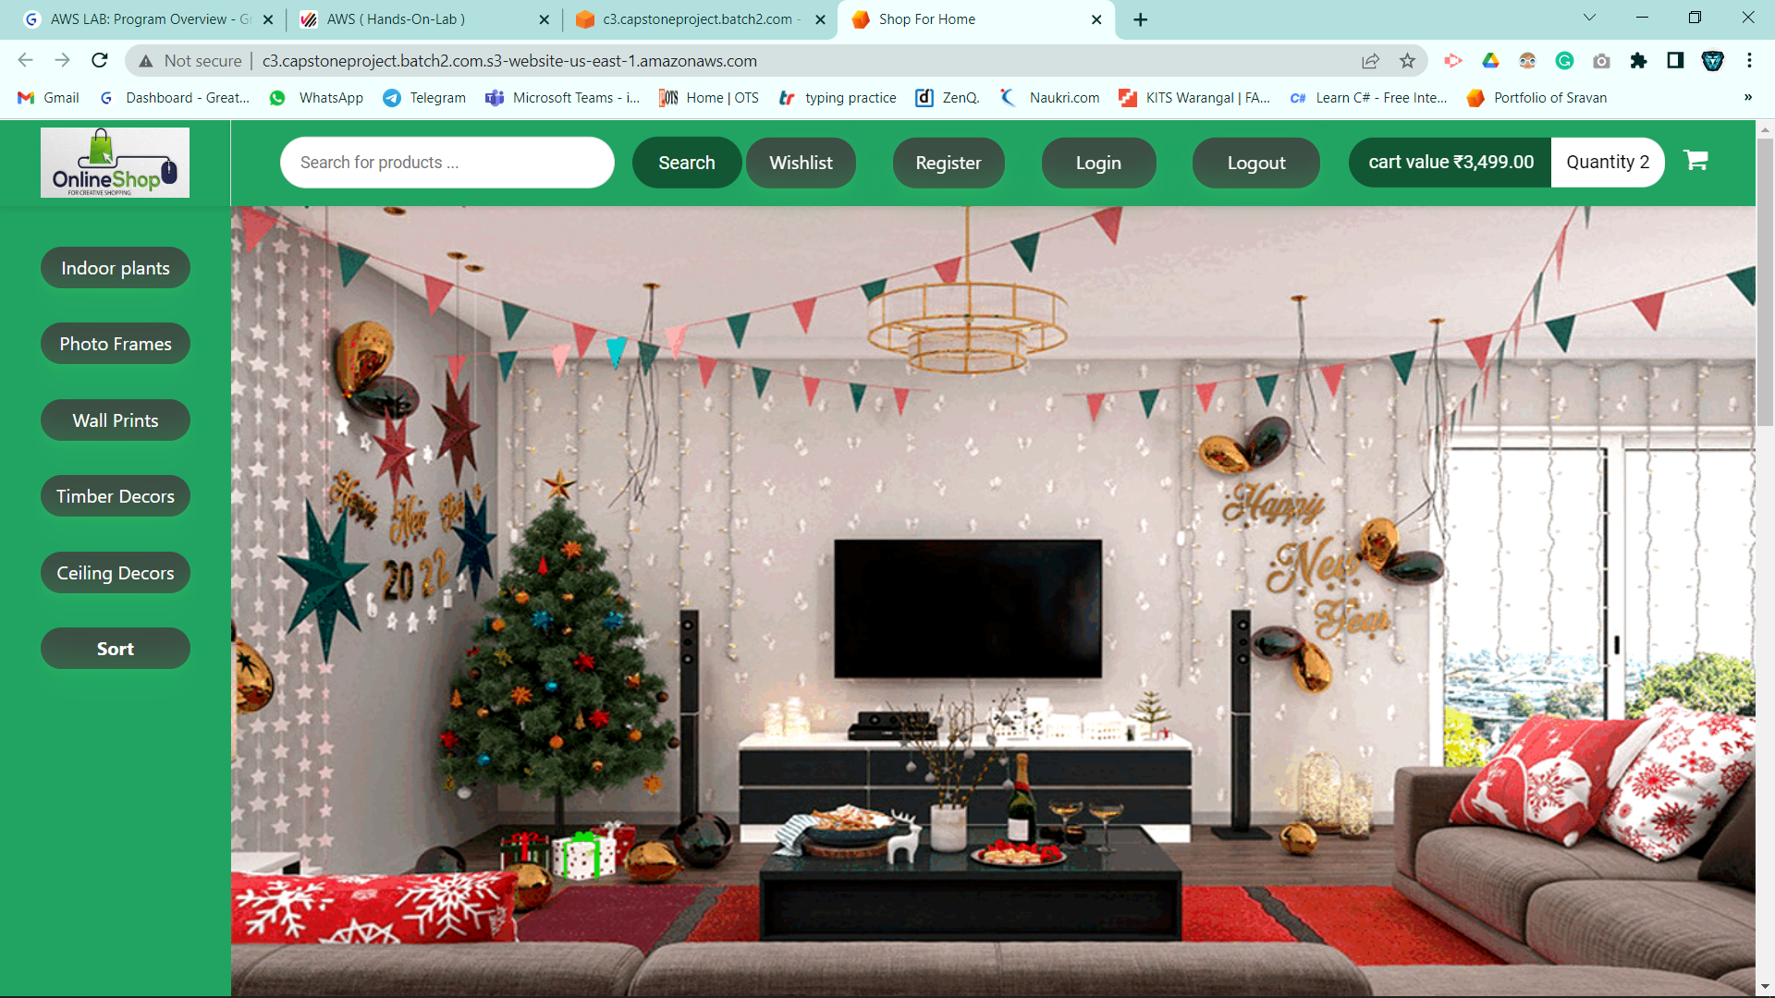
Aws Deployment

Slide 34
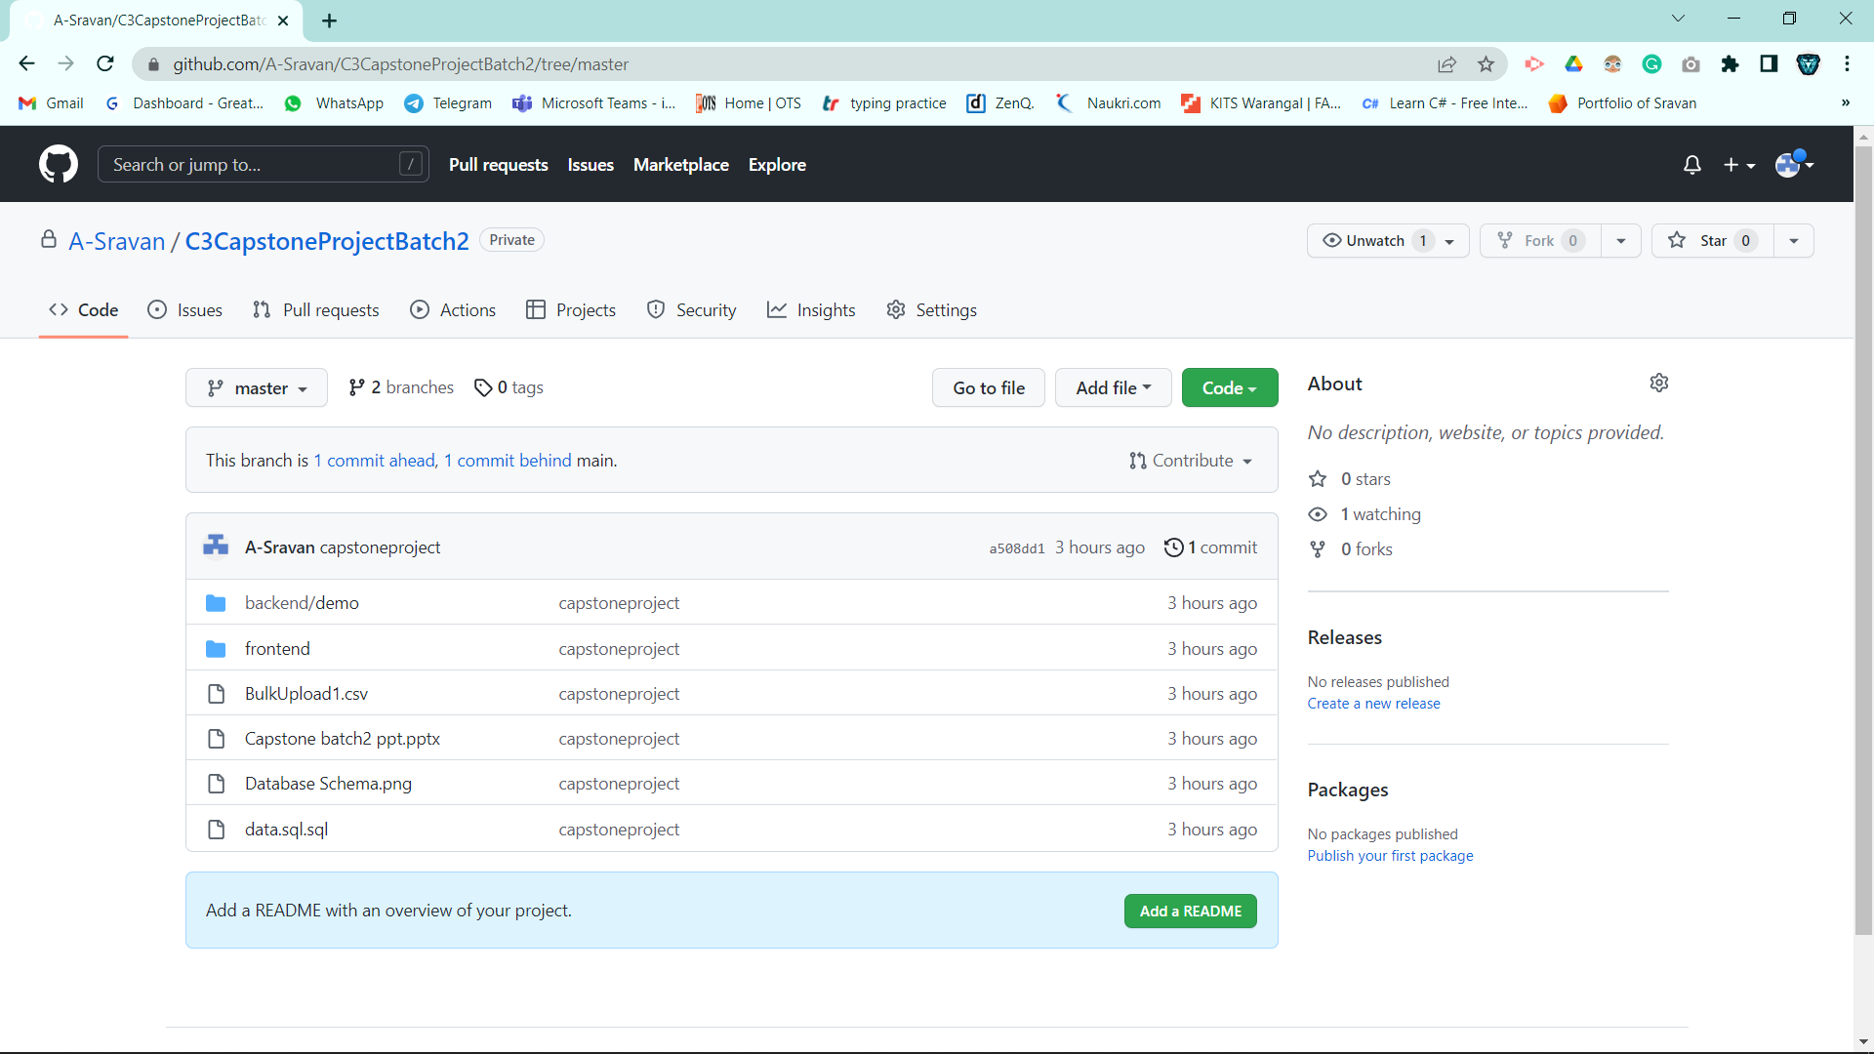
Git Repository

Slide 35
Conclusion
Technology has made significant progress over the years to provide consumers a better online shopping experience and will continue to do so for years to come.
The Application has been developed with free of errors and at the same time it is efficient and less time consuming.
The purpose of this project was to develop a web application for purchasing items from a shop.
With most of the E-retailers selling branded goods and having flexible return policies they are being well trusted by the users.
Online Shopping is better for both consumer and sellers.

Slide 36



THANK YOU

